Slide 1
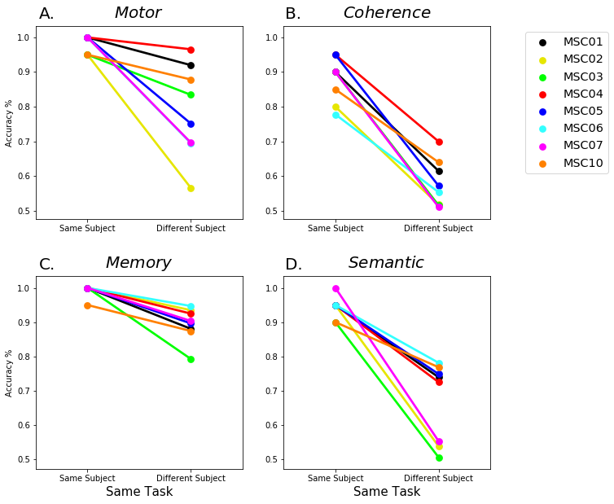
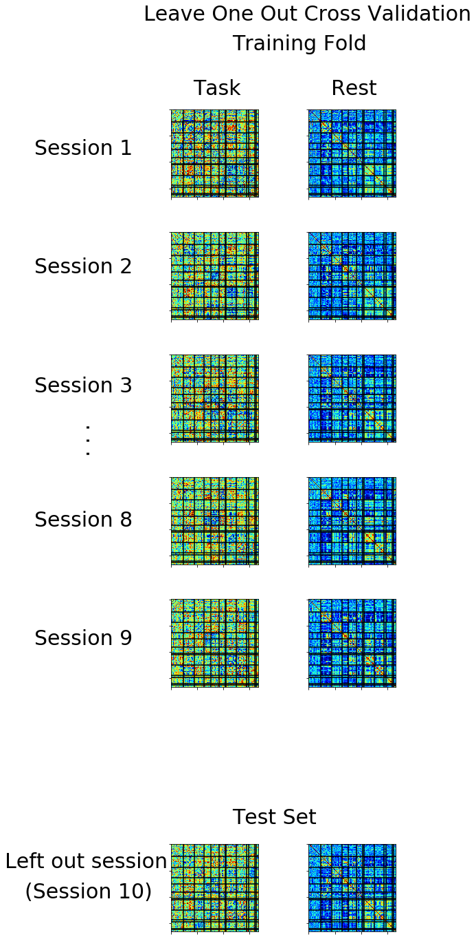
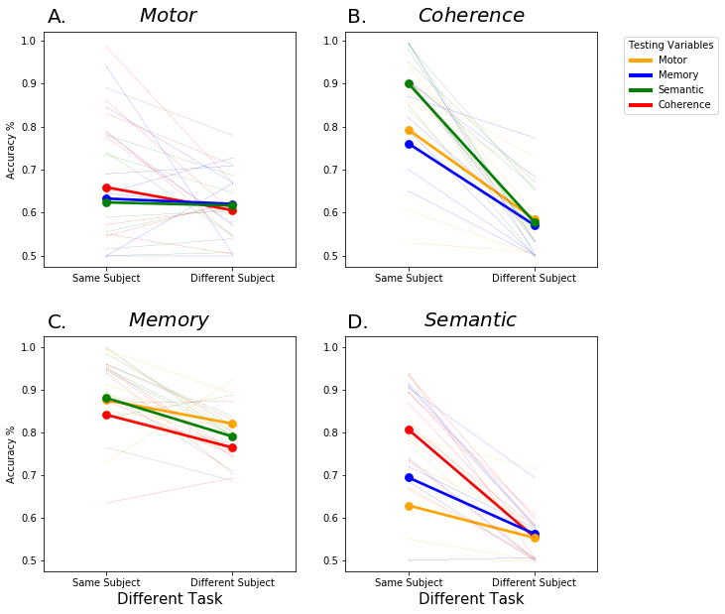
A.
Training
C.
Model Performance
Different Subject Same Task Test Sets
Midnight Scan Club
Semantic -MSC02
Individual Specific Analysis
4 Tasks x 10 Sessions x 10 Subjects
Classify
Semantic -MSC03
Semantic -MSC04
Memory
Motor
Semantic
Coherence
Testing Task FC
Testing Rest FC
Training Dataset
Classify
...
Fold 3
Fold 9
Fold 1
Fold 2
Fold 10
Individualized Classifiers
Task Generalizable Analysis
MSC01
MSC02
. . .
MSC10
Training Task FC
Training Rest FC
Testing Task FC
Testing Rest FC

Slide 2
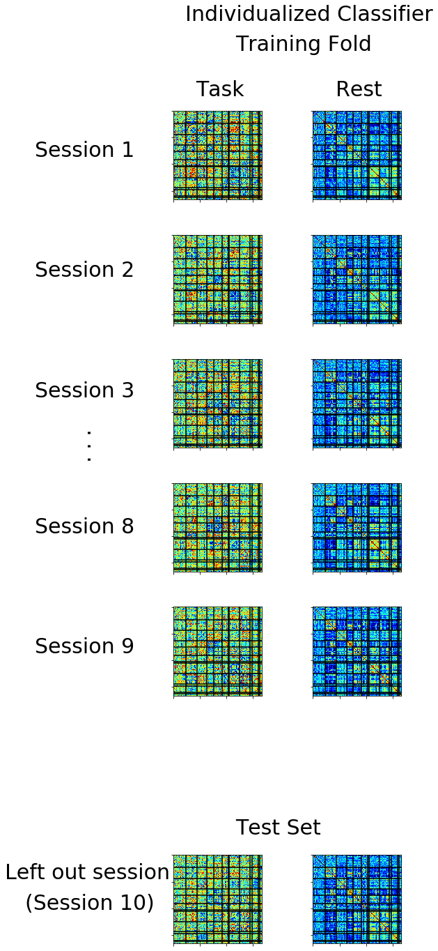
A.
Training
B.
Testing
C.
Evaluate Model Outcomes
Individual Specific Analysis
✓
High Accuracy
✗
Low Accuracy
Individualized Classifier
Different Subject Same Task
✓
✗
Classify
Between-subject generalizability
Subject specificity
Task Generalizable Analysis
Same Subject Different Task
✓
✗
Individualized Classifier
Classify
Within-subject cross-task generalizability
Within-subject task specificity
Individualized Classifier
Different Subject Different Task
✓
✗
Classify
Between-subject cross-task generalizability
Between-subject task specificity

Slide 3
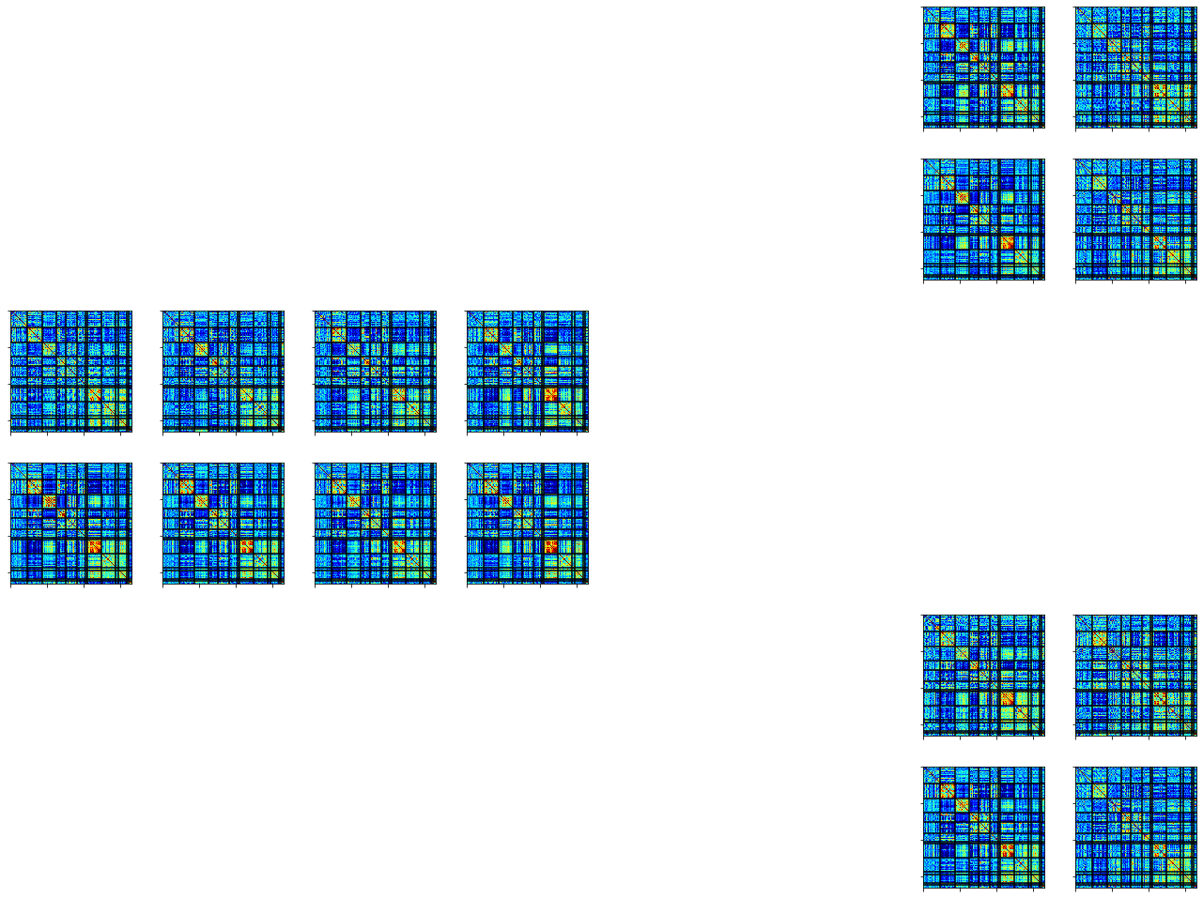
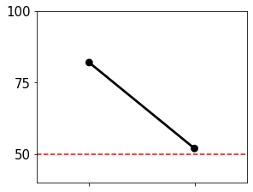
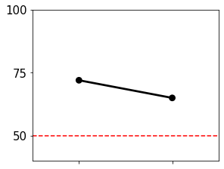
A.
Training
B.
Testing
C.
Evaluate
MSC04
Test
MSC05
Task A
Task A
Task A
Accuracy %
Rest
MSC04
MSC05
MSC04
MSC04
Rest
Accuracy %
Task B
Session 1
Session 2
…
Session 10
Session 3
Session 9
Session 10
Rest
Task A
Task B

Slide 4
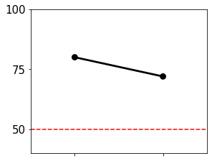
A.
Training
B.
Testing
MSC05
Task A
MSC04
Task A
Test
Task A
Rest
MSC04
MSC05
MSC04
MSC04
Task B
Rest
Rest
Task A
Task B
Session 10
Session 1
Session 2
…
MSC04
MSC05
Task B
Session 3
Session 9
Session 10
Task B
Rest
MSC04
MSC05

Slide 5
A.
Training
B.
Testing
C.
Evaluate
MSC04
MSC05
Task A
MSC04
Task A
Task A
Accuracy %
Rest
Rest
MSC04
MSC05
MSC04
Session 10
MSC04
Rest
Accuracy %
Task B
Session 1
Session 2
…
Task A
Task B
Session 3
Session 9
Rest

